Slide 1
Regression Analysis
Simple Linear Regression
Nicoleta Serban, Ph.D.
Professor
School of Industrial and Systems Engineering
Regression Concepts:
Statistical Inference Examples

Slide 2

About This Lesson

Slide 3
Linear Regression: Example in R
A company, which sells medical supplies to hospitals, clinics, and doctor's offices, had considered the effectiveness of a new advertising program.
Management wants to know if the advertisement is related to sales. This company intends to increase the sales with an effective advertising program.
What inferences can be made on the regression coefficients?

Slide 4
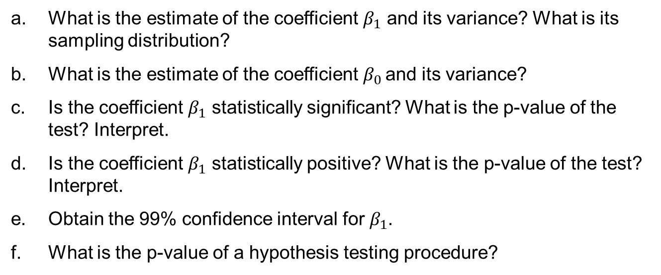
Example in R: Inference
What is the estimate of the coefficient $β_{1}$ and its variance? What is its sampling distribution?
What is the estimate of the coefficient $β_{0}$ and its variance?
Is the coefficient $β_{1}$ statistically significant? What is the p-value of the test? Interpret.
Is the coefficient $β_{1}$ statistically positive? What is the p-value of the test? Interpret.
Obtain the 99% confidence interval for $β_{1}$.
What is the p-value of a hypothesis testing procedure?

Slide 5
Example in R (cont’d)
summary(model)
Coefficients:
Estimate Std. Error t value Pr(>|t|)
(Intercept) -157.3301 145.1912 -1.084 0.29
adv 2.7721 0.2794 9.921 8.87e-10
Residual standard error: 101.4 on 23 degrees of freedom
The estimate for b₁ is 2.7721. The variance estimate is 0.2794². The sampling distribution is a t-distribution with 23 degrees of freedom.
The estimate for b₀ is -157.3301. The variance estimate is 145.1912².
The estimate for b₁ is statistically significant, as evidenced by a p-value of 8.87×10⁻¹⁰

Slide 6
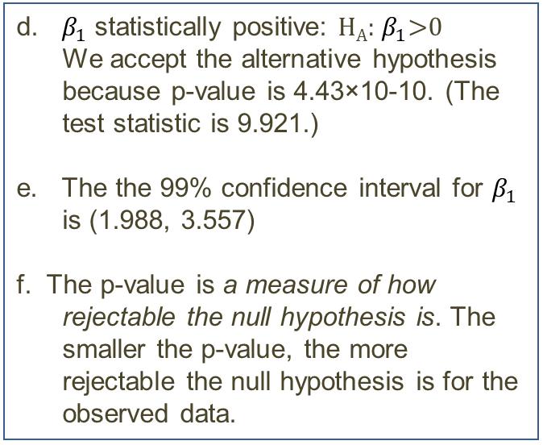
Example in R (cont’d)
d. $β_{1}$ statistically positive: H_{A}: $β_{1}$>0
We accept the alternative hypothesis because p-value is 4.43×10-10. (The test statistic is 9.921.)
e. The the 99% confidence interval for $β_{1}$ is (1.988, 3.557)
f. The p-value is a measure of how rejectable the null hypothesis is. The smaller the p-value, the more rejectable the null hypothesis is for the observed data.
tvalue = 9.921
1- pt(tvalue, 23)
[1] 4.433214e-10
confint(model, level=0.99)
0.5 % 99.5 %
(Intercept) -564.930546 250.27032
adv 1.987712 3.55652
Please read the P-value Statement by the American Statistical Association at:
https://doi.org/10.1080/00031305.2016.1154108

Slide 7

Summary

